Slide 1
Debugging in Ruby
Presented 05 June 2019@CSRug Ruby Meetup (first Wednesday in the month)
IDE => puts => … ?
=)K

Slide 2

Courtesy of the Naval Surface Warfare Center, Dahlgren, VA., 1988. (https://commons.wikimedia.org/wiki/File:H96566k.jpg), „H96566k“, marked as public domain, more details on Wikimedia Commons: https://commons.wikimedia.org/wiki/Template:PD-US
Notes:
“Debugging is the process of finding and resolving defects or problems within a computer program that prevent correct operation of computer software or a system.” (https://en.wikipedia.org/wiki/Debugging)
… or removing physical bugs from physical computers ;o)
Admiral Grace Hopper (Grace Brewster Murray Hopper, “Grandma COBOL”, lead FLOW-MATIC development)
https://en.wikipedia.org/wiki/Grace_Hopper

Slide 3
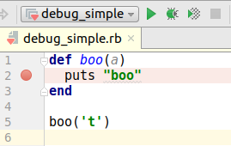
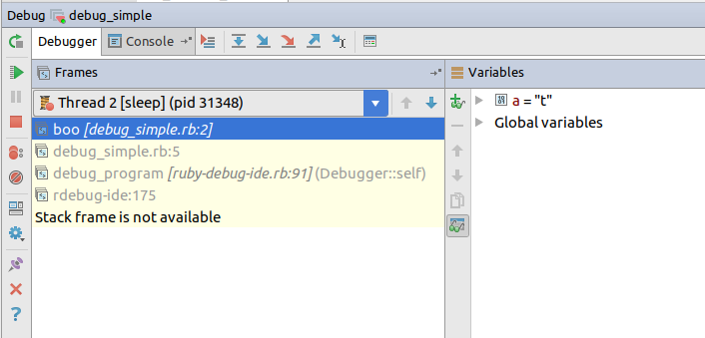
IDE (RubyMine 💜)

Slide 4
IDE (RubyMine 💜)

Slide 5

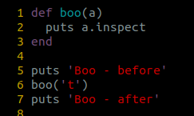
Puts
<-

Slide 6
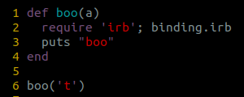
IRB (+PRY)
ruby 2.4.0, 2016-12-25
Notes:
https://www.ruby-lang.org/en/news/2016/12/25/ruby-2-4-0-released/
See the commit 8) <3
https://github.com/ruby/ruby/commit/493e48897421d176a8faf0f0820323d79ecdf94a

Slide 7
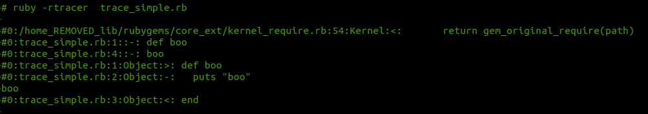
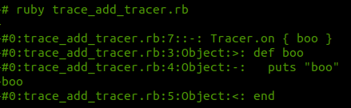
Tracer

Slide 8
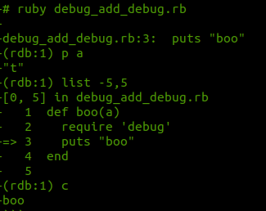
debug[ger] (+byebug)

Slide 9
…?
❎ IDE
❌ puts,p
❌ irb (pry and byebug)
❌ Debug(ger)

Slide 10
..."just force debug[ger] to continue instead of stopping and stop somewhere instead of continuing"...
⛔

Slide 11
Byebug
--no-stop
.byebugrc [~/, $PWD/]

Slide 12
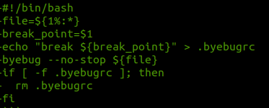
my_bug.bash

Slide 13


=)K
@otaznik_net
https://github.com/otaznik-net/debug_rb

